Slide 1
Face Rekognition Application using aws ml
Rishi Vyas M
24023401
GMBA(2024-2025)

Slide 2
Business scenario requirement
Imagine a Retail store which is constantly under threat of burglary, vandalism and theft. This would affect business operation immensely and affect function. My solution is a “ Face Rekognition App” integrated and Implemented with AWS Services which allows you to create a database of Known criminals/threats---train a model to Recognize them---Implement an App with basic UI to find a match with a good-enough Confidence score.
Ideal Solution: Integrate with live video streams to AWS Kinesis—frame extraction through Lambda code—The faces in the frame compare with indexed faces data—Return Notification via AWS SNS to store owner in case of suspicious activity/ flagged individual in store---Happens in real time.
My Solution: An app with UI where in the backend I have indexed faces “IndexFaces” Api---listed them---search new images with exiting ones in my custom dataset “SearchFacesByImage” API---Provide output if face matches—Image can be uploaded by user.
Scalability of database: I have code which updates the data in indexed faces file and list all the names of faces indexed already and only indexes those new faces updated in the database.

Slide 3
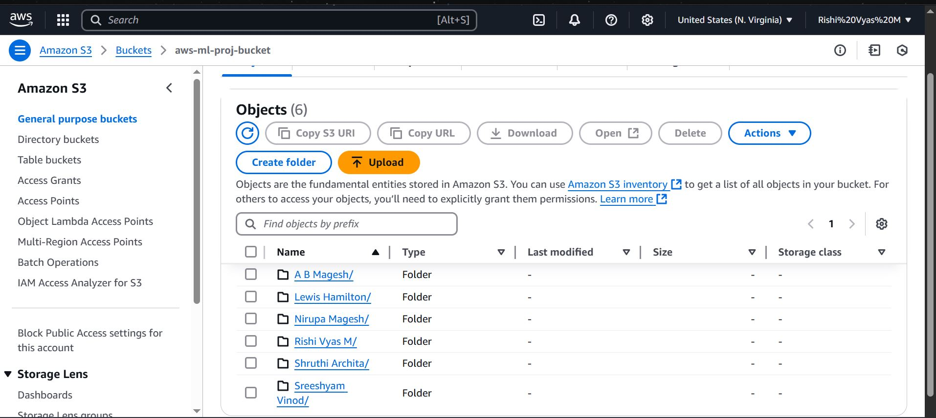
Step-1 , 2 & 3
Step-1: I created an AWS free tier account where i have 1 year free access to use services.
Step-2: I collected images of 6 close people to me in different angles (10-15 images each) and sorted them.
Step-3: I stored these images in a bucket I created on S3 for all my now and future Images if I want to scale up.

Slide 4
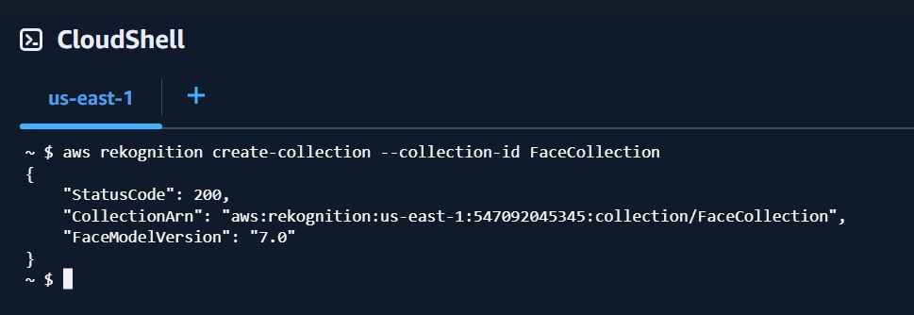
Step-4
Step-4: I logged in to AWS cloudshell CLI and created "FaceCollection" folder in AWS Rekognition where any folders with faces I index--the metadata, face Id, face embeddings etc will be stored---used the "IndexFaces" API.

Slide 5
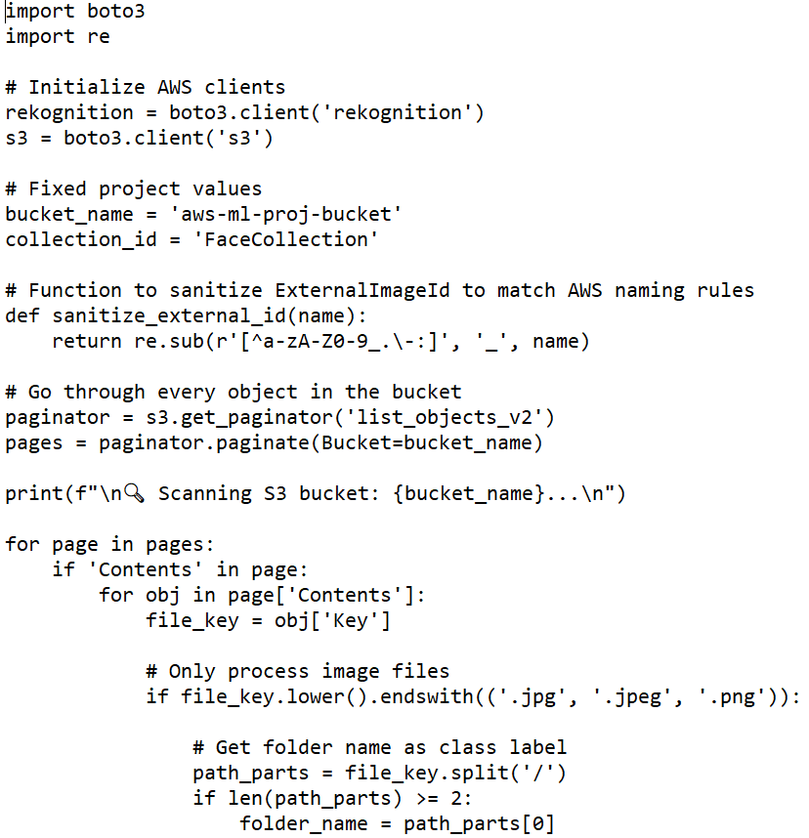
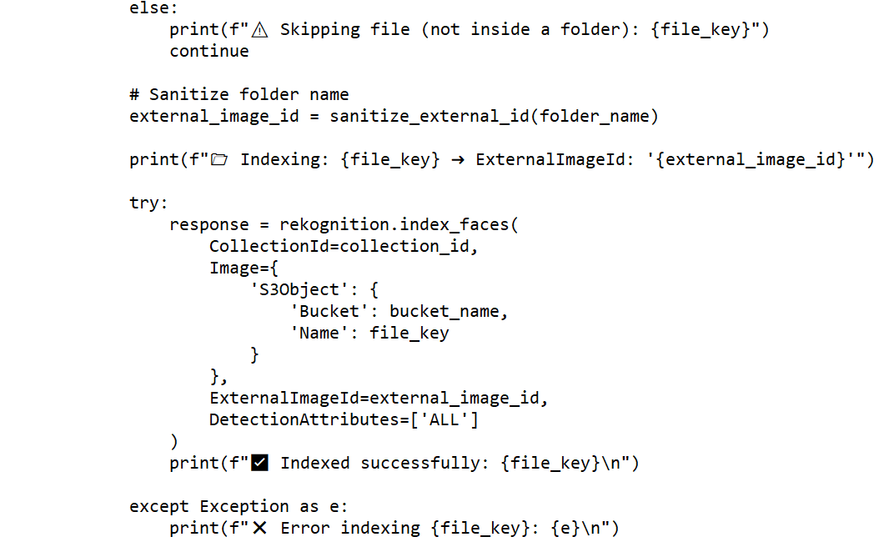
Step-5
Step-5: I created 3 python Scripts--"index_faces"--Indexes the folder in my bucket with all images and attaches the folder name(person's name) as an "ExternalImageID". This will be output during rekognition because even if AWS indexes faces of same person, each image has a unique FaceID assigned.
Code snippet is below.

Slide 6
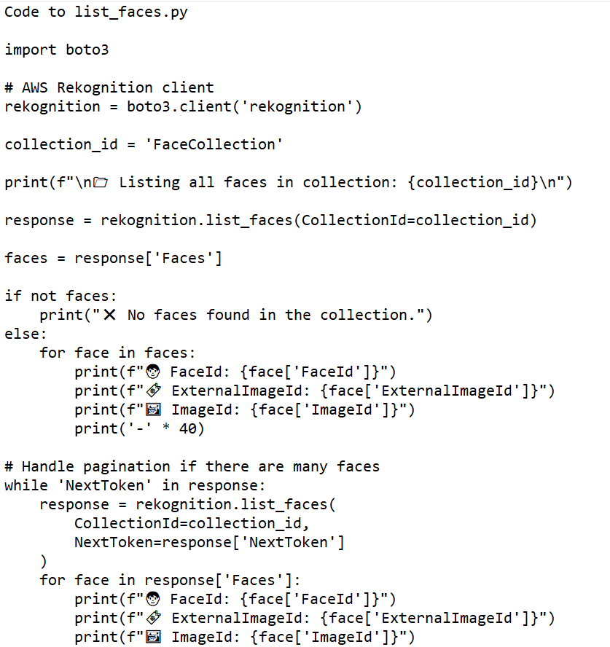
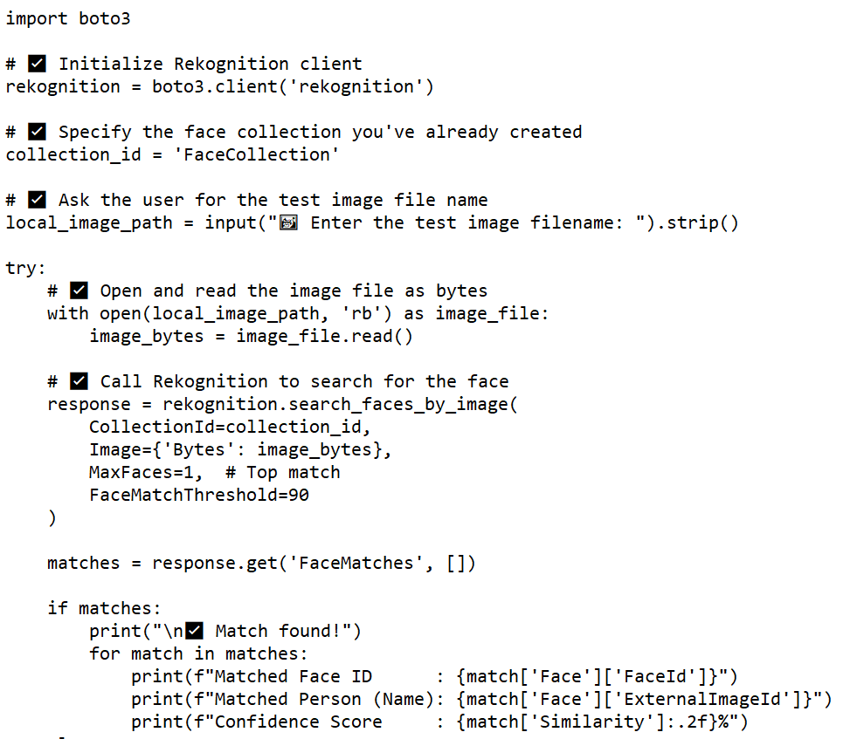
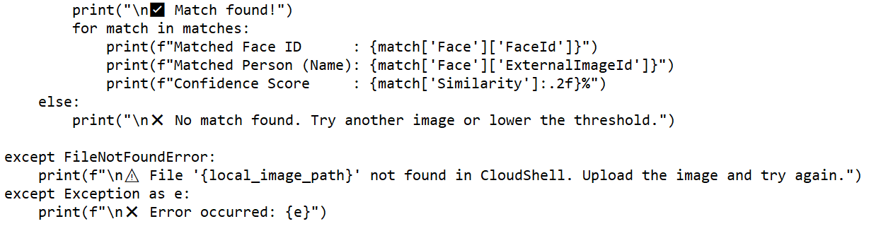
Step-6
Step:6 I created the "list_faces" code to check if all folders and images were indexed and "search_faces" code using the "SeachFacesByImage"API--It uses the image i upload--indexes it and compares it with the images information stored in "FaceCollection" to find a match. Then it outputs the "External Image ID" with a confidence score percentile.
Code to search_faces

Slide 7
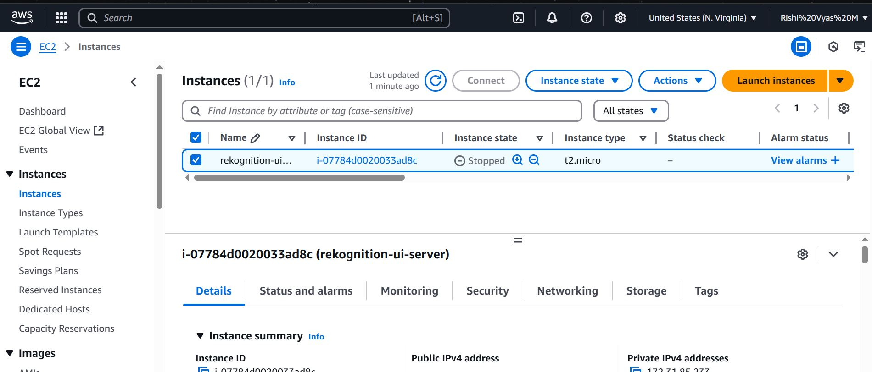
Step-7
Step-7: I wanted to make it with a basic UI and application code. Hence, I launched an EC2 instance, with keys and security groups--Specific Inbound rules! to allow access from any IP address on port 5000.
(NOTE: I also created code to "index_new_faces" as they are added in my Images bucket---So that I can scale this.)

Slide 8
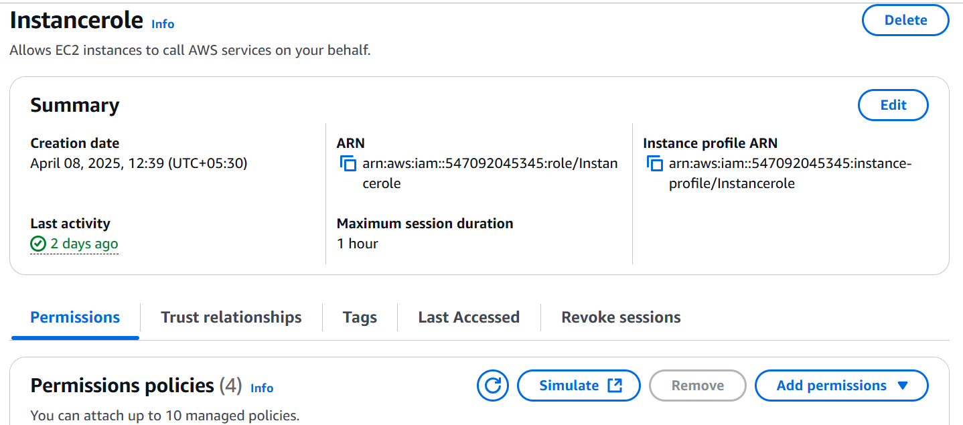
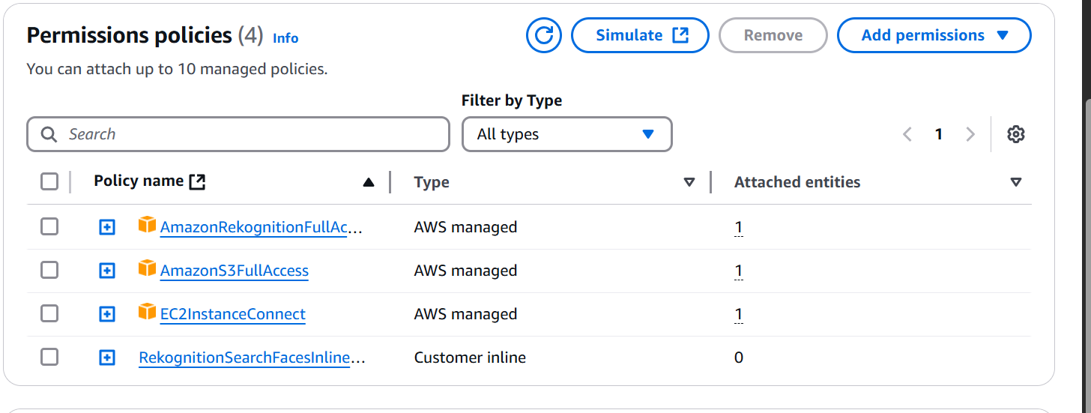
STEP-8
Step-8: I created necessary role and attached EC2,Rekognition.S3 full access to it and made the instance assume that role----It give permissions to access (S3,EC2,Rekognition)

Slide 9
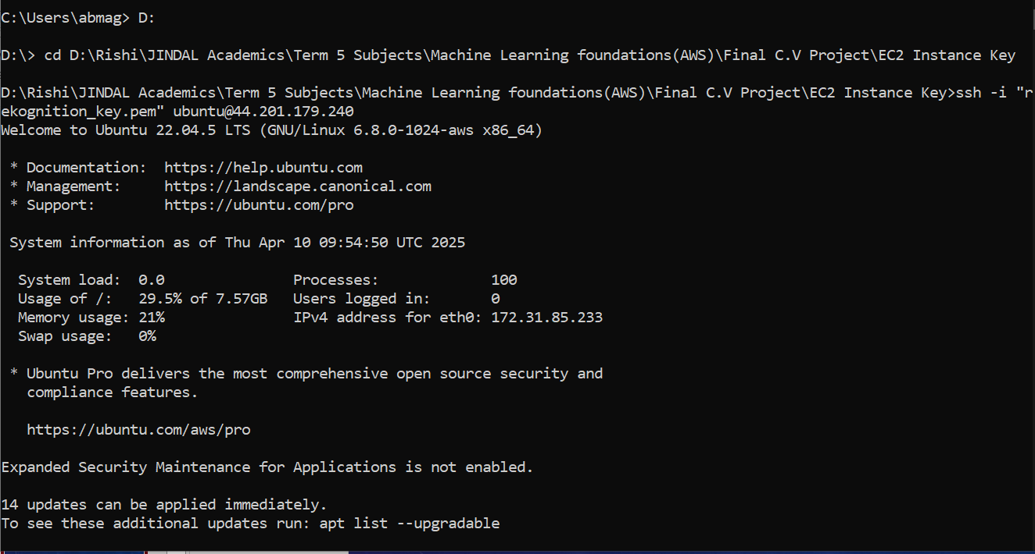
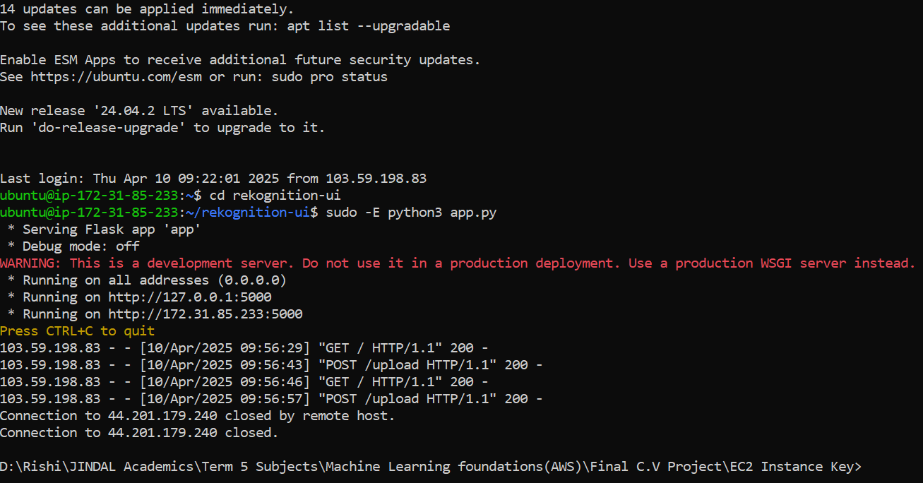
Step-9 & 10
Step-9: I connected to the EC2 via my CLI and Instance Key by SSH ing into it, created directories for app and html code---- I created my "app.py" code to use my work on the backend to do the FaceMatching LIKE i SAID and basic HTML code for a UI.-----I launched it in the IPV4 address of my code--- the UI opens.
Step-10: I can upload any image of a person part of my database/collection of Images and it will immediately identify and flag them!!! and In my testing It works.

Slide 10
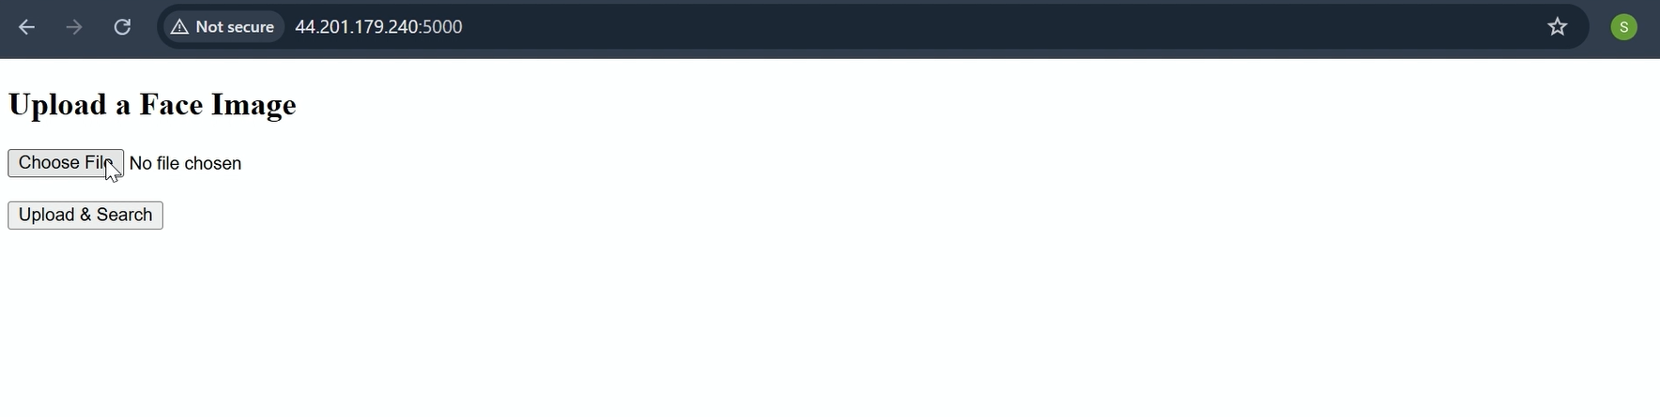
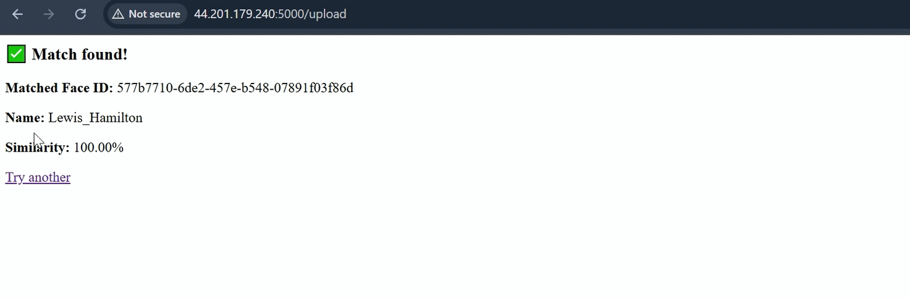

Slide 11
Thank You

